Slide 1



Applications of Calculus in BUSINESS ECONOMICS
Shaheer Ali.
ME(A)

Slide 2
What is Calculus?
Calculus, originally called infinitesimal calculus or "the calculus of infinitesimals", is the mathematical study of continuous change, in the same way that geometry is the study of shape and algebra is the study of generalizations of arithmetic operations.

Slide 3
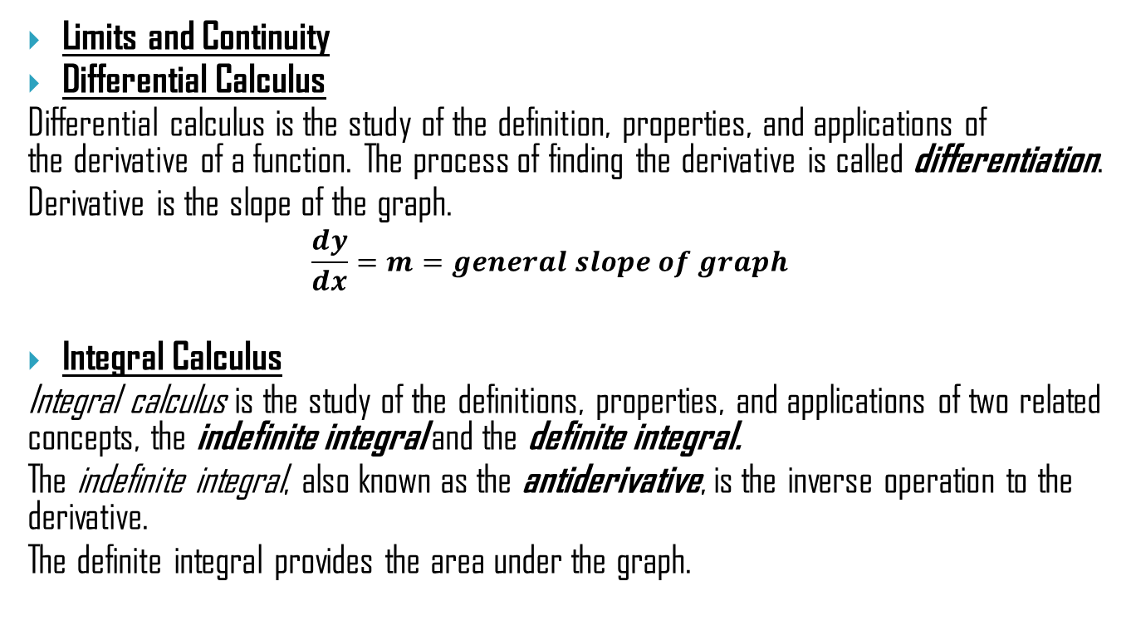
Branches of Calculus
Limits and Continuity
Differential Calculus
Differential calculus is the study of the definition, properties, and applications of the derivative of a function. The process of finding the derivative is called differentiation.
Derivative is the slope of the graph.
$$\frac{dy}{dx}=m=general slope of graph$$
Integral Calculus
Integral calculus is the study of the definitions, properties, and applications of two related concepts, the indefinite integral and the definite integral.
The indefinite integral, also known as the antiderivative, is the inverse operation to the derivative.
The definite integral provides the area under the graph.

Slide 4
Calculus in Business Economics
Business Economics is defined as the branch of economics that enables owners to analyze their business, revenue, profit and expenditures and enables them to plan their ventures accordingly.
In Business, Calculus is mainly used for optimization. This includes maximizing profits, minimizing cost, and maximizing or minimizing production. Also, Calculus can be used to calculate the rate of change in cost or the marginal revenue for an interest-bearing account. General Applications of Calculus in business are:
OPTIMIZATION
MAXIMIZING PROFITS
MINIMIZING COSTS
MARGINAL ANALYSIS OF REVENUE, COSTS AND PROFIT

Slide 5
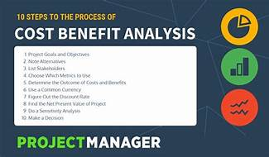
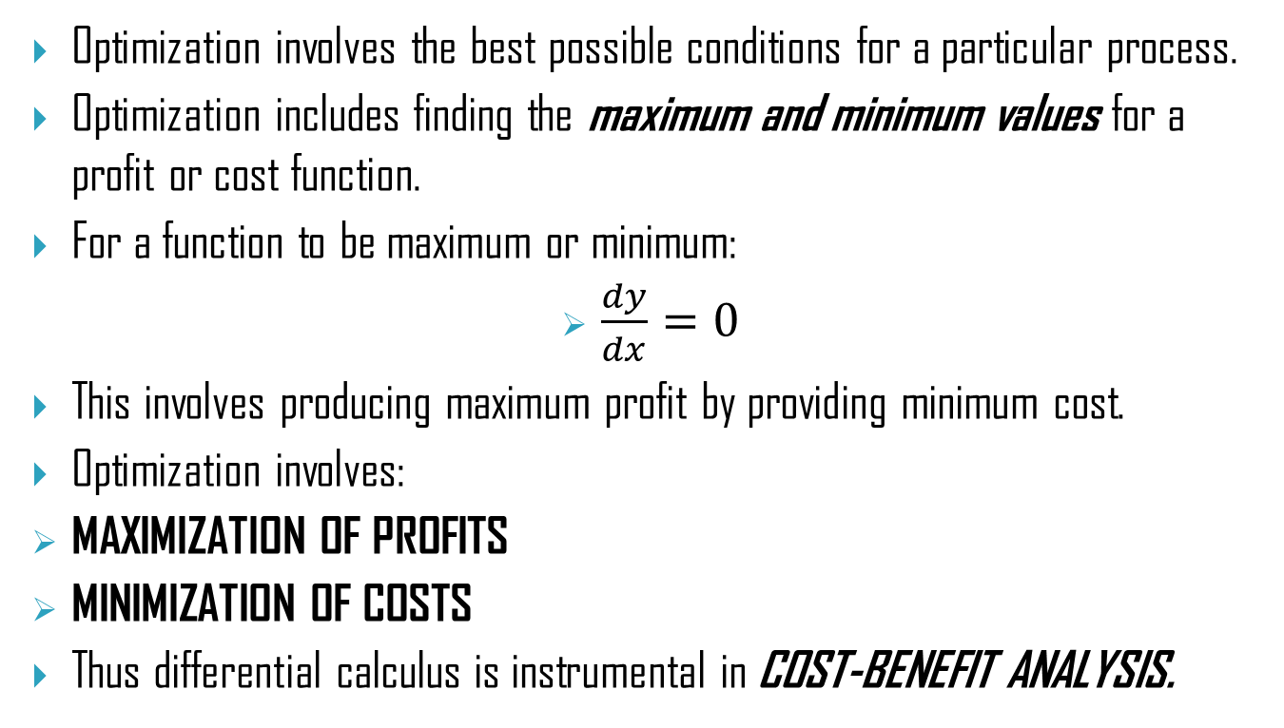
Optimization
Optimization involves the best possible conditions for a particular process.
Optimization includes finding the maximum and minimum values for a profit or cost function.
For a function to be maximum or minimum:
$\frac{dy}{dx}=0$
This involves producing maximum profit by providing minimum cost.
Optimization involves:
MAXIMIZATION OF PROFITS
MINIMIZATION OF COSTS
Thus differential calculus is instrumental in COST-BENEFIT ANALYSIS.

Slide 6
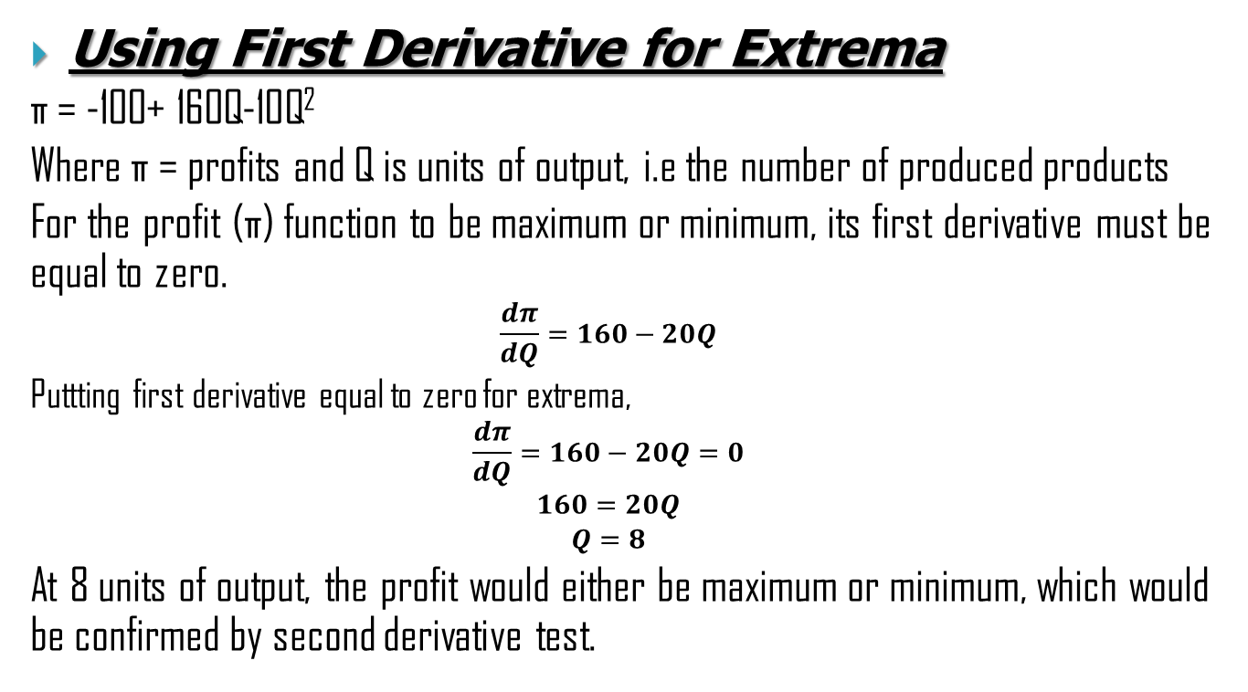
Maximization of Profits
Using First Derivative for Extrema
π = -100+ 160Q-10Q²
Where π = profits and Q is units of output, i.e the number of produced products
For the profit (π) function to be maximum or minimum, its first derivative must be equal to zero.
$$\frac{dπ}{dQ}=160−20Q$$
Puttting first derivative equal to zero for extrema,
$$\frac{dπ}{dQ}=160−20Q=0$$
$$160=20Q$$
$$Q=8$$
At 8 units of output, the profit would either be maximum or minimum, which would be confirmed by second derivative test.

Slide 7
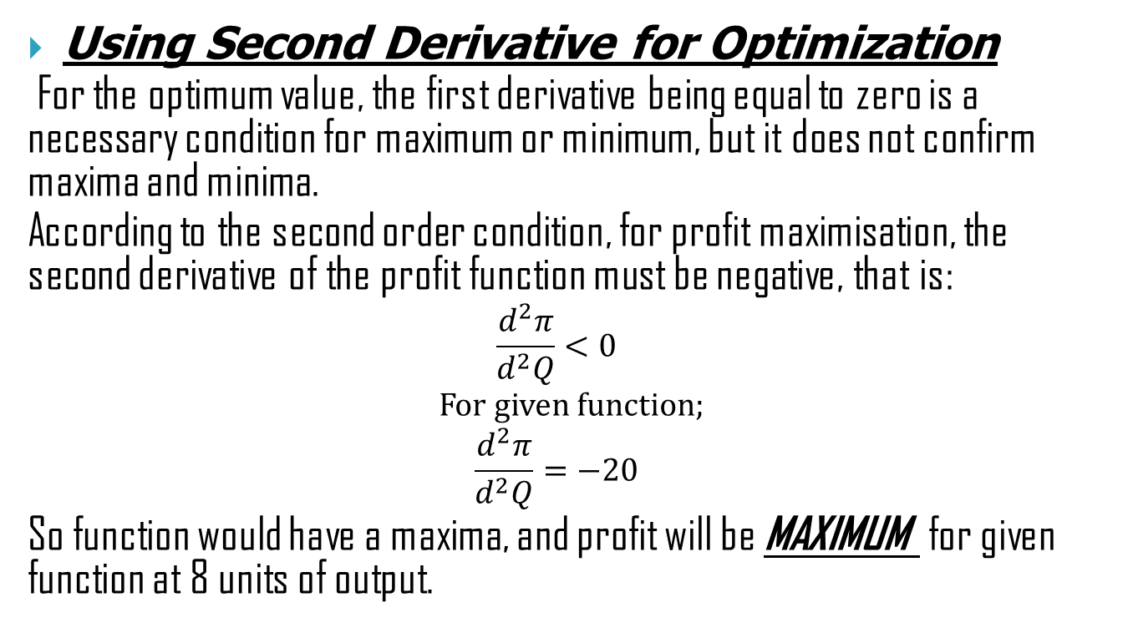
Continued…
Using Second Derivative for Optimization
For the optimum value, the first derivative being equal to zero is a necessary condition for maximum or minimum, but it does not confirm maxima and minima.
According to the second order condition, for profit maximisation, the second derivative of the profit function must be negative, that is:
$$\frac{d^{2}π}{d^{2}Q}<0$$
For given function;
$$\frac{d^{2}π}{d^{2}Q}=−20$$
So function would have a maxima, and profit will be MAXIMUM for given function at 8 units of output.

Slide 8
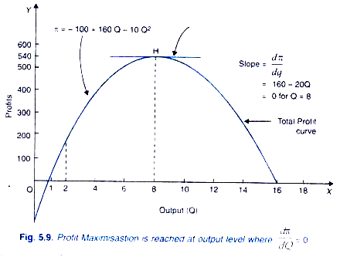
Graphically

Slide 9
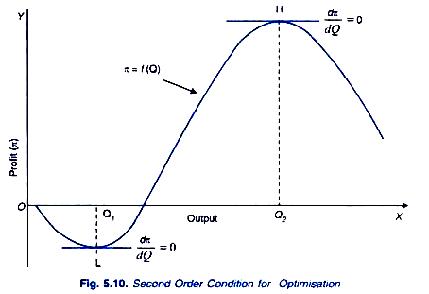
Continued…

Slide 10

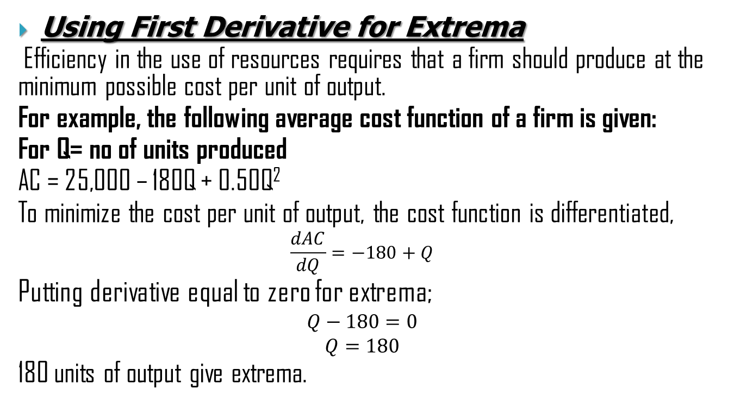
Minimization of Costs
Using First Derivative for Extrema
Efficiency in the use of resources requires that a firm should produce at the minimum possible cost per unit of output.
For example, the following average cost function of a firm is given:
For Q= no of units produced
AC = 25,000 – 180Q + 0.50Q²
To minimize the cost per unit of output, the cost function is differentiated,
$$\frac{dAC}{dQ}=−180+Q$$
Putting derivative equal to zero for extrema;
$$Q−180=0$$
$$Q=180$$
180 units of output give extrema.

Slide 11

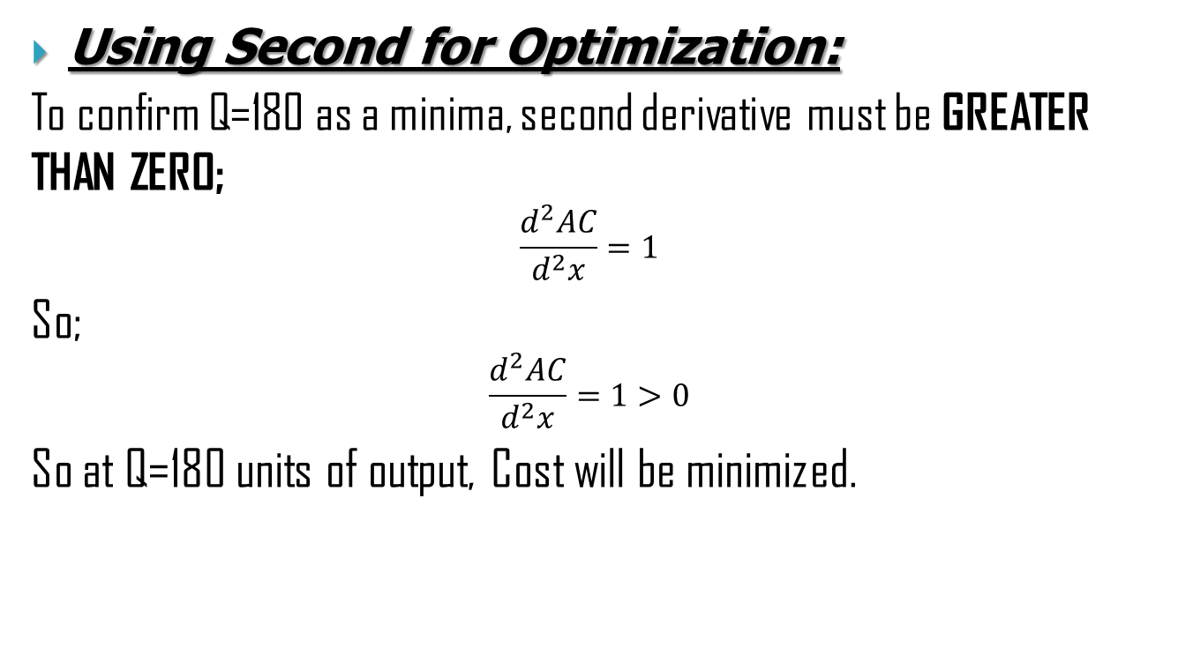
Continued…
Using Second for Optimization:
To confirm Q=180 as a minima, second derivative must be GREATER THAN ZERO;
$$\frac{d^{2}AC}{d^{2}x}=1$$
So;
$$\frac{d^{2}AC}{d^{2}x}=1>0$$
So at Q=180 units of output, Cost will be minimized.

Slide 12
Graphically

Slide 13
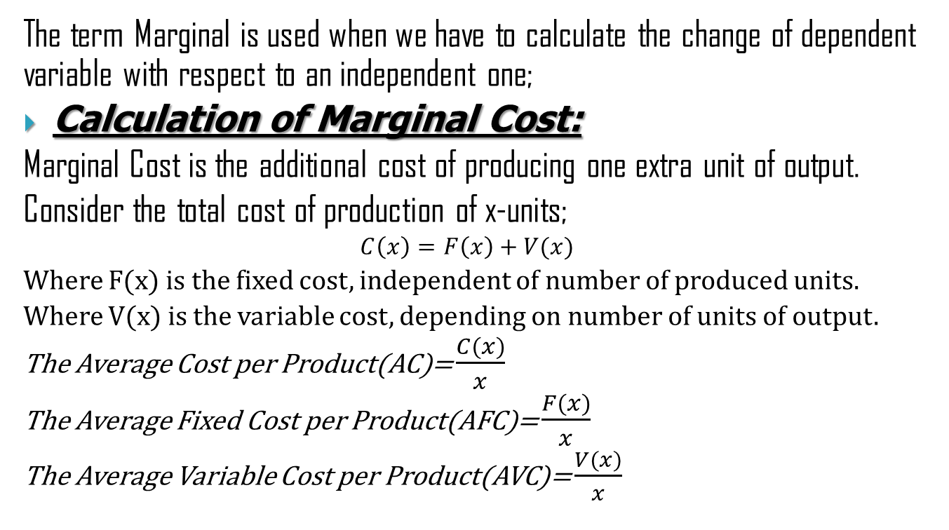
Marginal Analysis of Profit, Revenue and Cost
The term Marginal is used when we have to calculate the change of dependent variable with respect to an independent one;
Calculation of Marginal Cost:
Marginal Cost is the additional cost of producing one extra unit of output.
Consider the total cost of production of x-units;
$$C\left(x\right)=F\left(x\right)+V(x)$$
Where F(x) is the fixed cost, independent of number of produced units.
Where V(x) is the variable cost, depending on number of units of output.
The Average Cost per Product(AC)= $\frac{C(x)}{x}$
The Average Fixed Cost per Product(AFC)= $\frac{F(x)}{x}$
The Average Variable Cost per Product(AVC)= $\frac{V(x)}{x}$

Slide 14
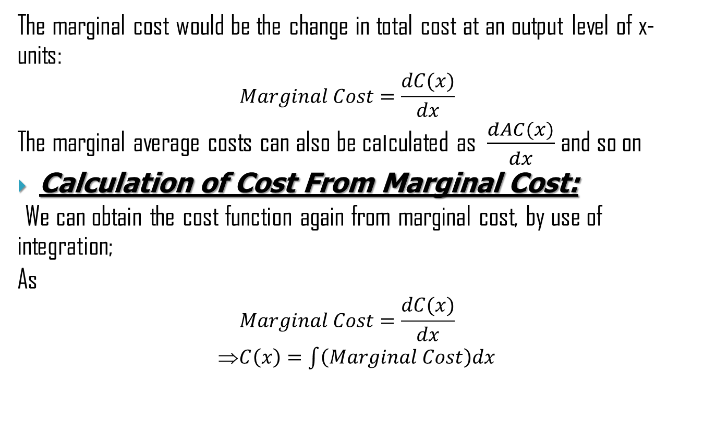
Continued…
The marginal cost would be the change in total cost at an output level of x-units:
$$Marginal Cost=\frac{dC(x)}{dx}$$
The marginal average costs can also be calculated as $\frac{dAC(x)}{dx}$and so on
Calculation of Cost From Marginal Cost:
We can obtain the cost function again from marginal cost, by use of integration;
As
$$Marginal Cost=\frac{dC(x)}{dx}$$
⇒$C\left(x\right)=\int{\left(Marginal Cost\right)dx}$

Slide 15

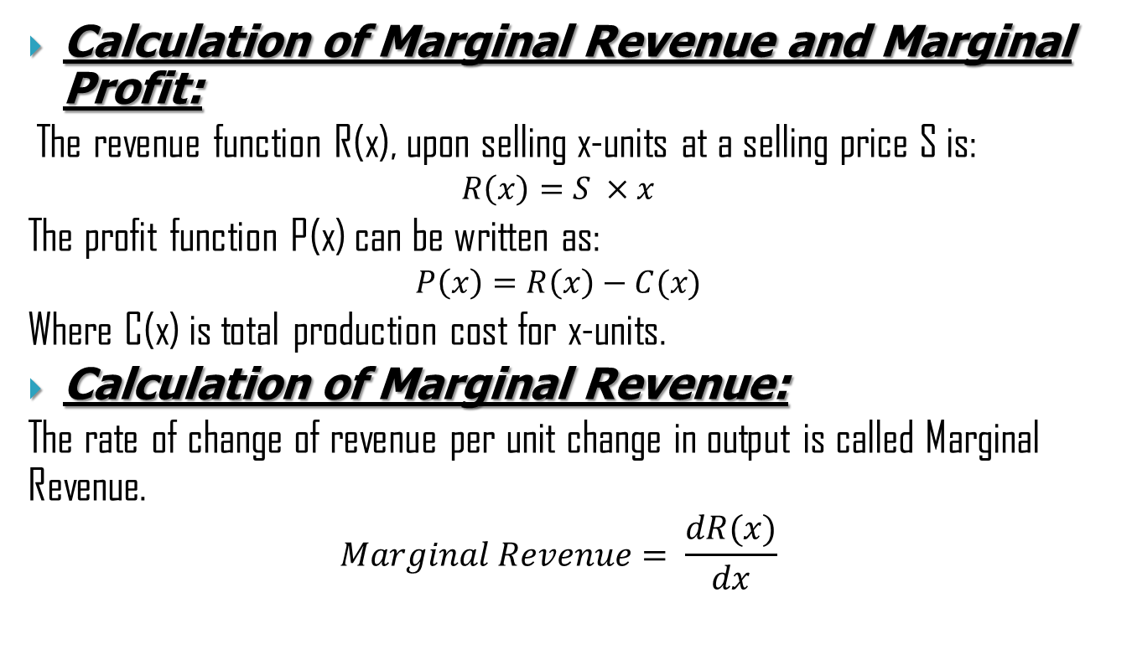
Profit
Calculation of Marginal Revenue and Marginal Profit:
The revenue function R(x), upon selling x-units at a selling price S is:
$$R\left(x\right)=S ×x$$
The profit function P(x) can be written as:
$$P\left(x\right)=R\left(x\right)−C(x)$$
Where C(x) is total production cost for x-units.
Calculation of Marginal Revenue:
The rate of change of revenue per unit change in output is called Marginal Revenue.
$$Marginal Revenue= \frac{dR(x)}{dx}$$

Slide 16
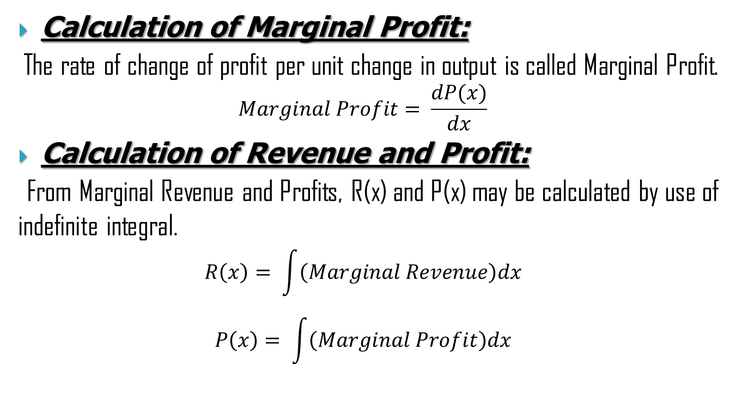
Continued…
Calculation of Marginal Profit:
The rate of change of profit per unit change in output is called Marginal Profit.
$$Marginal Profit= \frac{dP(x)}{dx}$$
Calculation of Revenue and Profit:
From Marginal Revenue and Profits, R(x) and P(x) may be calculated by use of indefinite integral.
$$R\left(x\right)= \int{\left(Marginal Revenue\right)dx}$$
$$P\left(x\right)= \int{\left(Marginal Profit\right)dx}$$

Slide 17
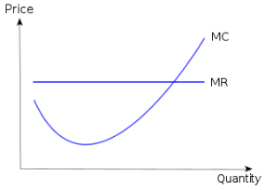
Graph

Slide 18
Conclusion
Calculus is the most fundamental tool used in business economics.
The above mentioned applications are utilized in Business Economics.
The calculation of marginal quantities, combined with the use of extrema allow us to find the best possible business conditions.
Thus Calculus allows business owners to manage their business related activities more effectively, allowing greater progress and profits.

